Slide 1
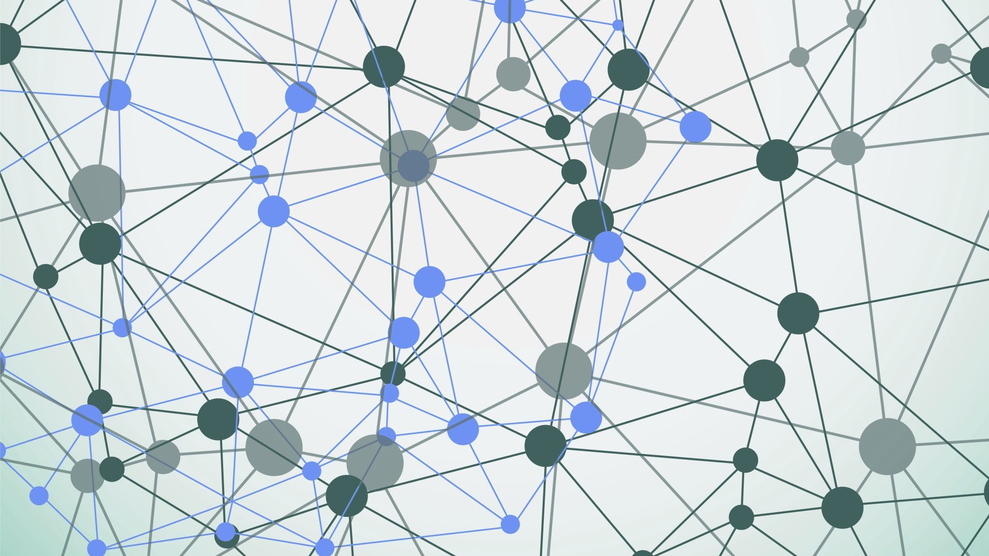
Gratitude++ Design Presentation
By
Joel Scott
Benjamin Seifried

Slide 2
Agenda
Block Diagram
Component Diagram
UI Storyboard
Message Documentation
Storage Documentation

Slide 3
Introduction
The project will use a mobile first approach.
The website will be run through Replit as a server
Will utilize Google Firebase for data storage and retrieval.
Will be designed for rendering in Google's Chrome Browser

Slide 4
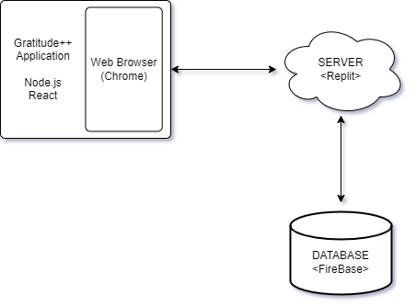
Block Diagram

Slide 5
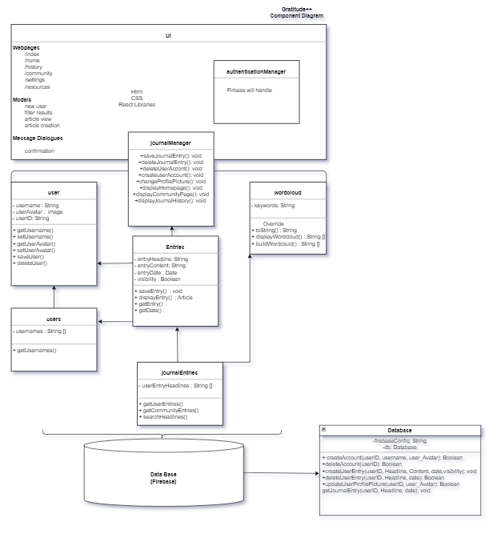
Component Diagram
The components of the Gratitude++ Application will be loosely structured in a layered architecture.
The user interface will be constructed with the React libraries utilizing html and css stylization.
There will be a journalManager class that will pass function call communication between the UI and the classes doing the "work".
Firebase NoSQL database will be the foundation and handle authentication

Slide 6
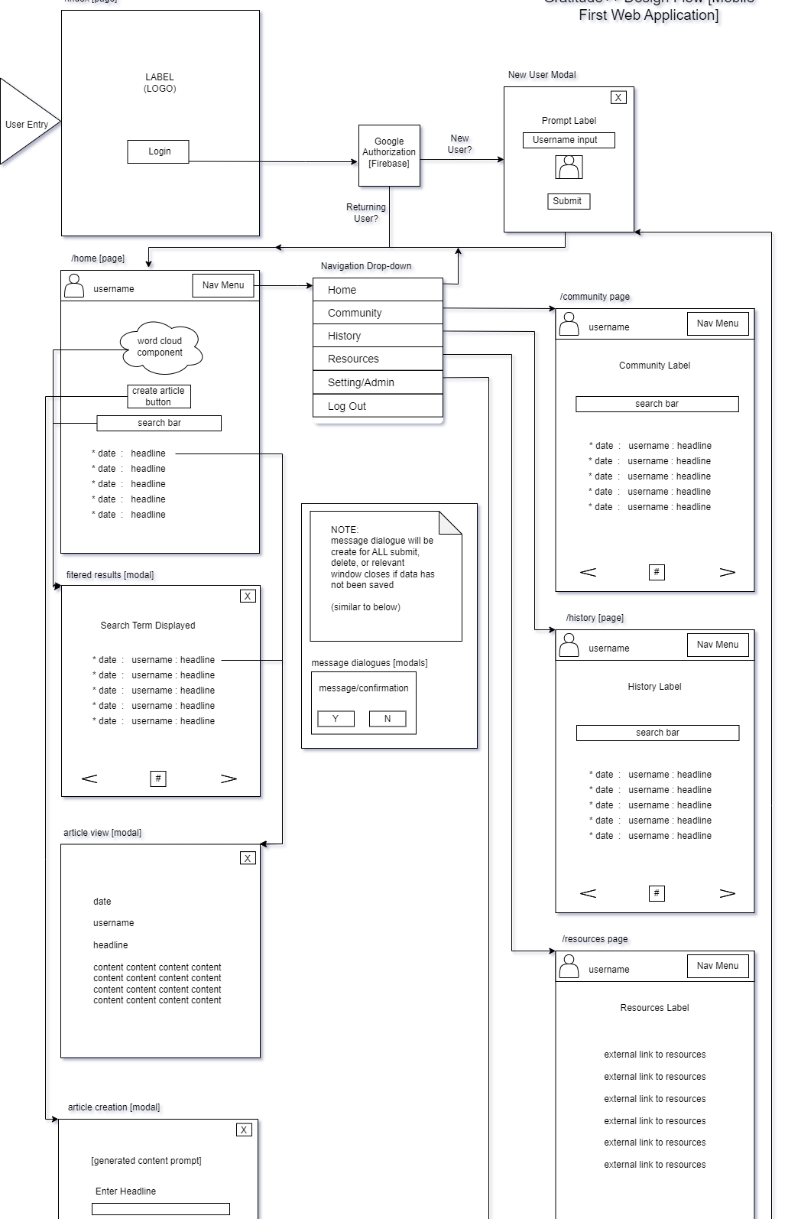
UI Storyboard
The User interface will consist of -
Webpages
Modals
Message Dialogues

Slide 7
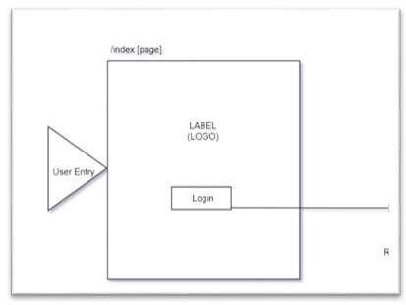
Index Page
User Entry
Login

Slide 8
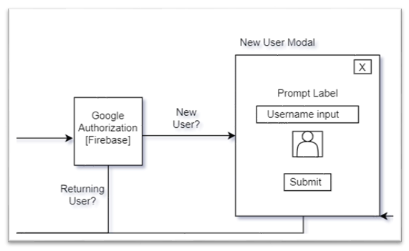
Authentication and New User Creation
Google Firebase Authentication
-Redirects returning users to Home Page
-New Users are directed to New User Modal

Slide 9
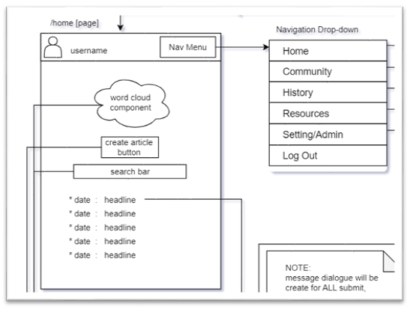
Home Page and Navigation
All Pages other than the index will have a navigation bar
Page includes:
World Cloud Component
Create Article Button
Search Bar
Abbreviated list of current posts

Slide 10
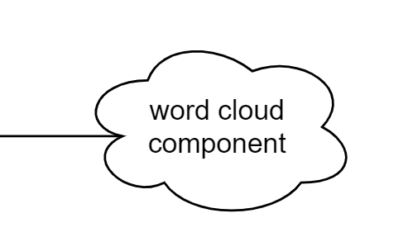
Word Cloud Component
Displayed prominently on the user's homepage
Is a collection of key words taken from an individual user's journal entry headlines.
Key Words will be clickable and create an instance of the filtered results modal populated with entries that have headlines containing the key word selected

Slide 11
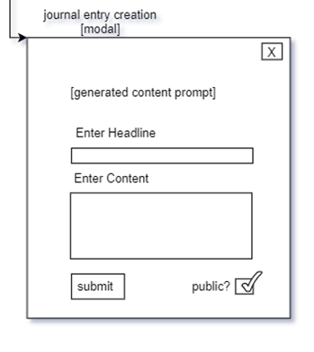
Journal Entry Creation Modal
Prompts
Labels
Inputs
Visibility Checkbox or Toggle
Submit Button

Slide 12
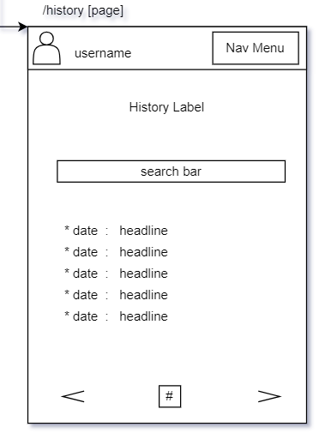
History Page
Page Label
Search Bar
List of user's previous journal entries

Slide 13
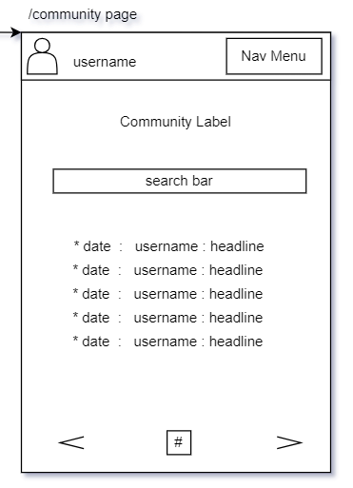
Community Page
Page Label
Search Bar
List of all Public Entries from all users
Ability to "flag" post and remove visibilty

Slide 14
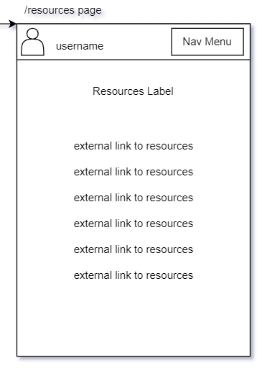
Resources Page
Page Label
Links to helpful websites and resources in-line with the mission of the Gratitude++ Web Journal

Slide 15
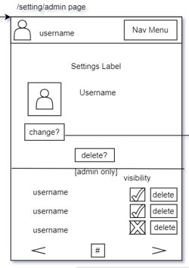
Settings/Admin Page
Page Label
Ability to Change Profile Avatar Image
Ability to Delete Account
ADMIN ONLY SECTION
Can see all users
Deny approve or deny user visibility on community page
Can delete user accounts

Slide 16
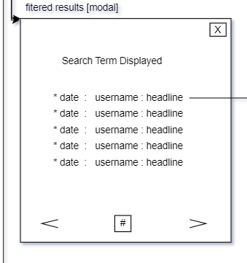
Filtered Results Modal
Used anytime filtered results are displayed from any page or modal
Label showing term Searched for
List of Journal Entries

Slide 17
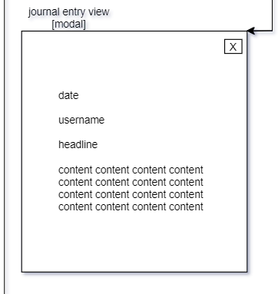
Journal Entry View Modal
Simplified viewing modal for distraction free experience while reading

Slide 18
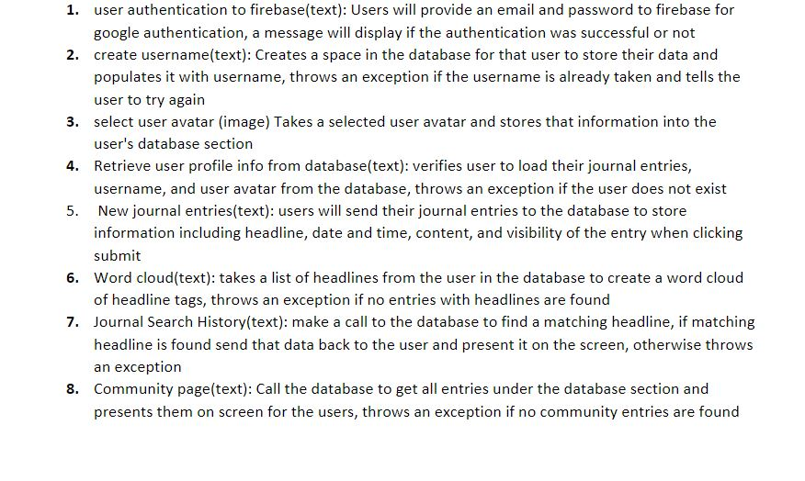
Message Documentation

Slide 19
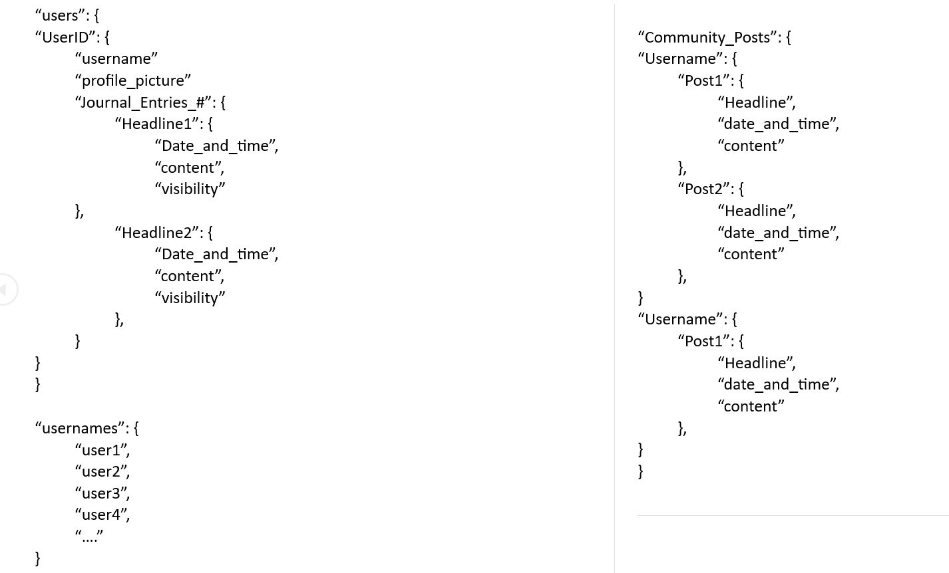
Storage Documentation

Slide 20
In Conclusion
There are many "unknown" unknowns in this project.
The designs provided should establish an adequate roadmap moving forward for the developers
Changes and additions are sure to arise and will be documented throughout the development process

Slide 21
Thank You

